Slide 1
Edible Plant Identification through Leaf Matching
Christine Opiekun and Weiqi Wang

Slide 2
Goals vs Current Implementation:
Goals
Current Implementation
Finalized Database with pre-calculated image identifiers
Real time identification of leaves
Accuracy above 70%
In a subset of species the accuracy is higher
Leaf identification for one leaf performed in 4 s
Correct leaf species in first 5 guesses: 80%

Slide 3


Segmentation
Original Image
K-means Clusters
Tophat

Slide 4
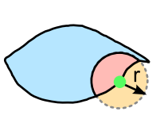
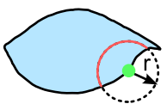
Leaf Identification: Extracting Curvature Features
Area Measurement
Arc Length Measurement

Slide 5
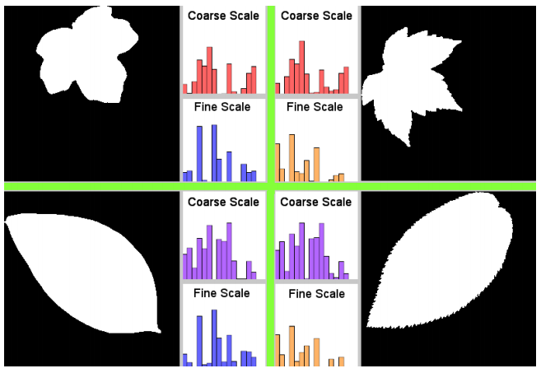
Leaf Identification: Extracting Curvature Features cont.

Slide 6
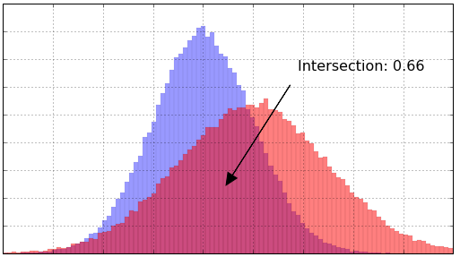
Nearest-Neighbor Linear Search

Slide 7
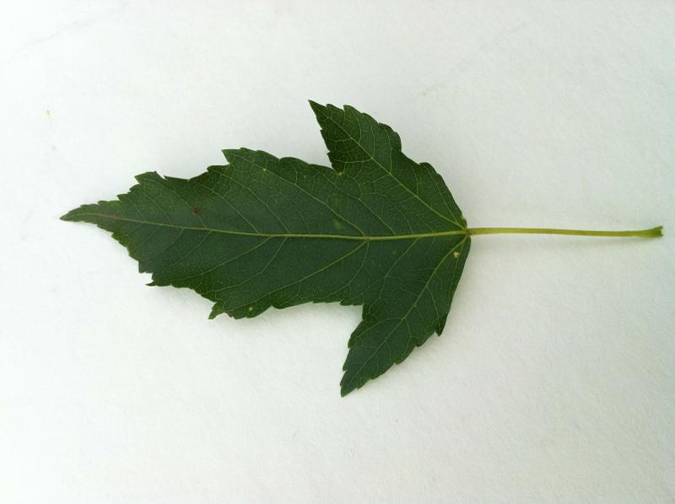
Demo
Acer (Maple Family)
Acer Ginnala (Amur Maple)

Slide 8
References
[1] Belhumeur, Peter N., et al. "Searching the world’s herbaria: A system for visual identification of plant species." European Conference on Computer Vision. Springer Berlin Heidelberg, 2008.
[2] Kumar, Neeraj, et al. "Leafsnap: A computer vision system for automatic plant species identification." Computer Vision–ECCV 2012. Springer Berlin Heidelberg, 2012. 502-516.
[3] Ling, Haibin, and David W. Jacobs. "Shape classification using the inner-distance." IEEE transactions on pattern analysis and machine intelligence29.2 (2007): 286-299.
[4] "Histogram Intersection For Change Detection | Diving Into Data". Blog.datadive.net. N.p., 2016. Web. 6 Dec. 2016.
[5] Söderkvist, Oskar. "Computer vision classification of leaves from swedish trees." (2001).

Slide 9
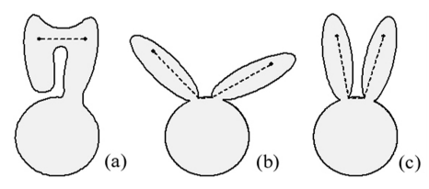

Leaf Identification: Inner Distance Shape Context (IDSC)
Inner Distance
Inner Angle

